Slide 1

Object Detection 目标检测
Object localization
目标定位
deeplearning.ai

Slide 2
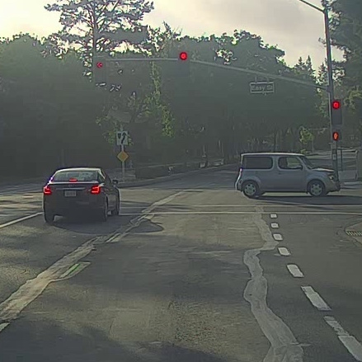
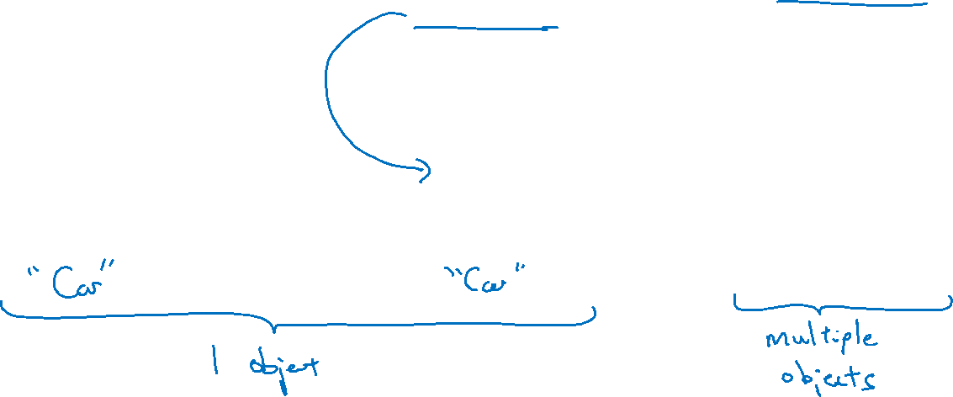
What are localization and detection?
Image classification
Classification with
localization
Detection

Slide 3


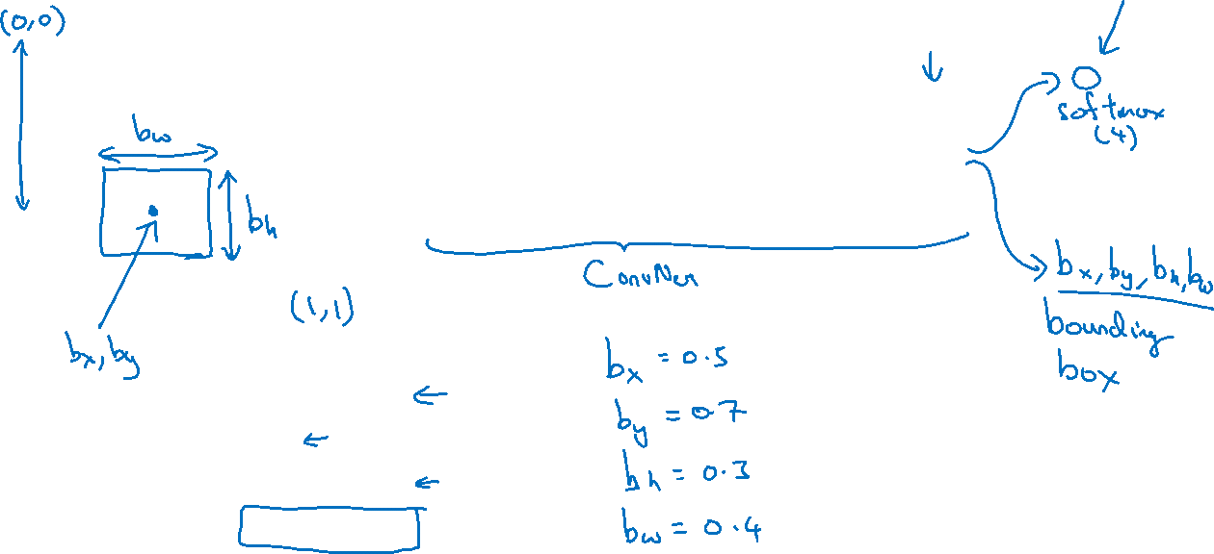
Classification with localization
$$⋯$$
$$⋮$$
1 - pedestrian
2 - car
3 - motorcycle
4 - background

Slide 4
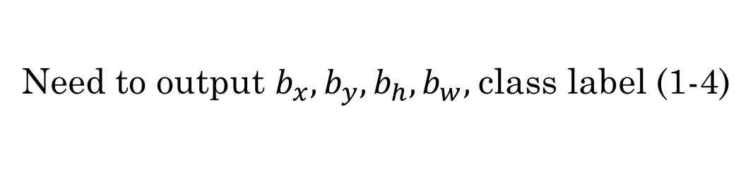
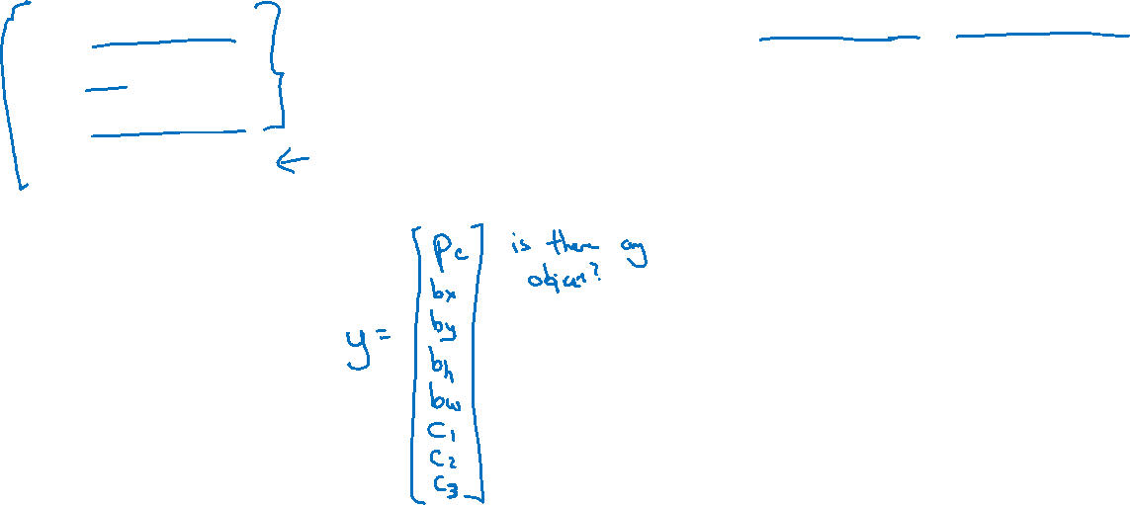
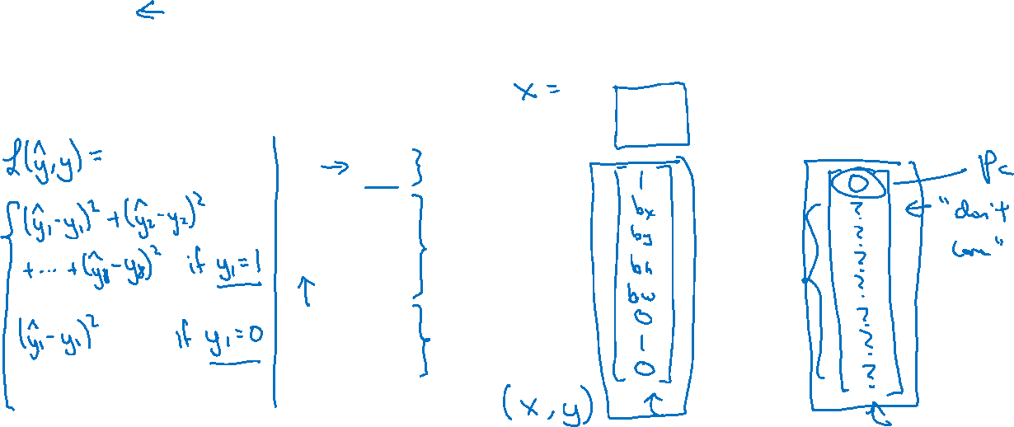
Defining the target label y
1 - pedestrian
Need to output $b_{x},b_{y},b_{h}, b_{w},$class label (1-4)
2 - car
3 - motorcycle
4 - background

Slide 5
Object Detection 目标检测
Landmark detection
特征点检测
deeplearning.ai

Slide 6
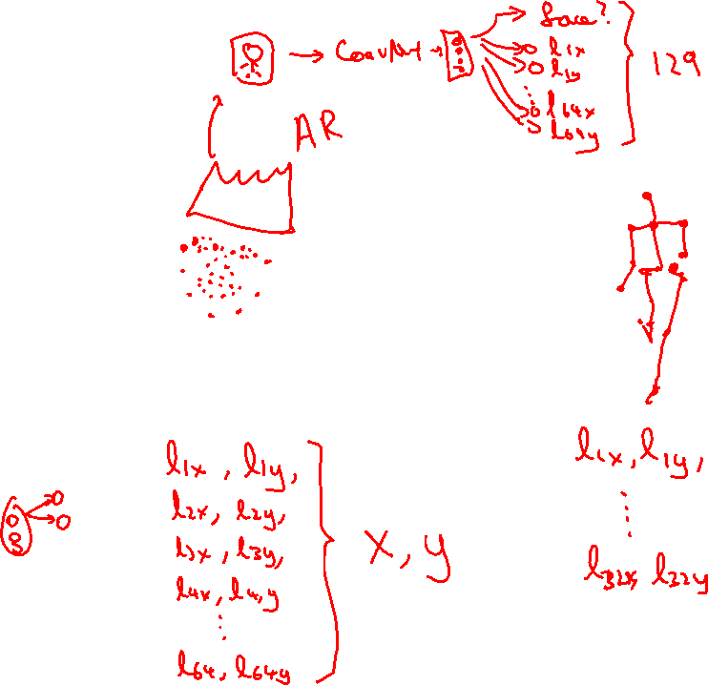
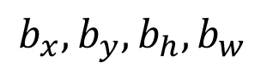
Landmark detection
ConvNet
$$b_{x},b_{y},b_{h}, b_{w}$$

Slide 7
Object Detection
Object detection
deeplearning.ai

Slide 8
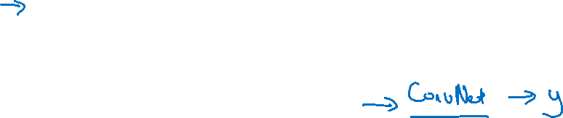
Car detection example
Training set:
x
y
1
1
1
0
0

Slide 9
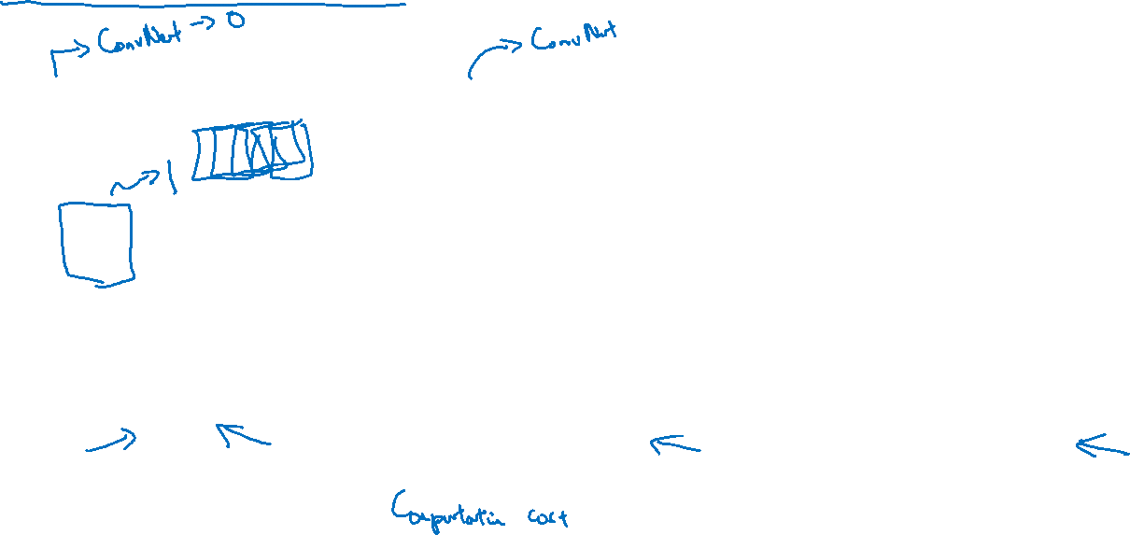
Sliding windows detection

Slide 10
Object Detection
Convolutional implementation of sliding windows
deeplearning.ai

Slide 11
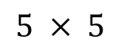
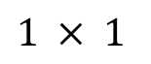
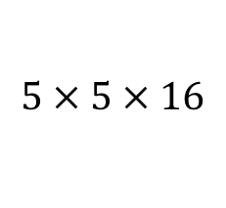
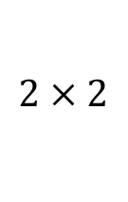
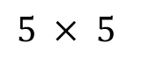
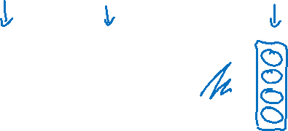
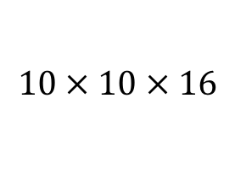
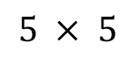
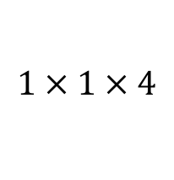
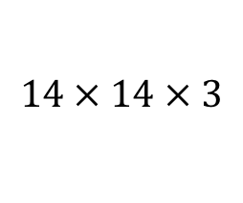

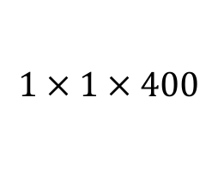
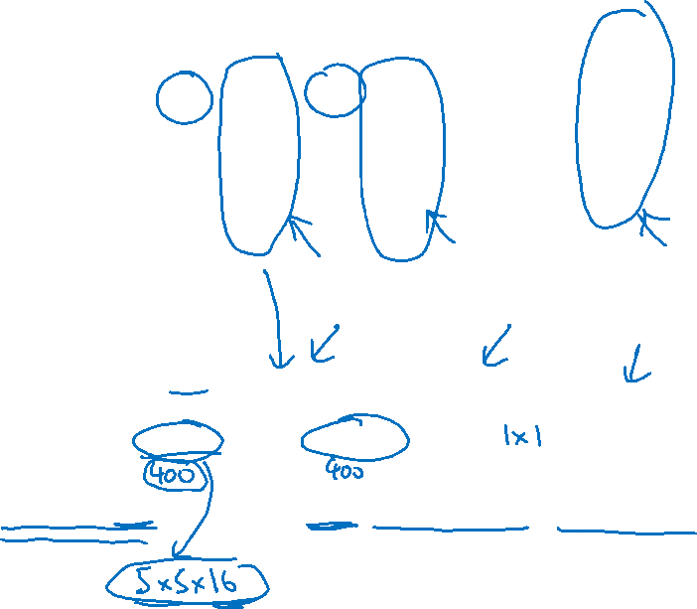
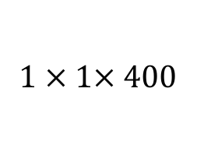
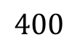

Turning FC layer into convolutional layers
MAX POOL
FC
FC
$$5 × 5$$
$$2 × 2$$
$$⋮$$
$$⋮$$
y
softmax (4)
$$14 × 14 × 3$$
$$10 × 10 × 16$$
$$5 × 5 × 16$$
$$400$$
$$400$$
MAX POOL
FC
FC
$$5 × 5$$
$$2 × 2$$
$$5 × 5$$
$$1 × 1$$
$$14 × 14 × 3$$
$$10 × 10 × 16$$
$$5 × 5 × 16$$
$$1 × 1× 400$$
$$1 × 1 × 400$$
$$1 × 1 × 4$$

Slide 12
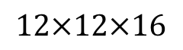
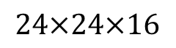
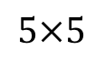
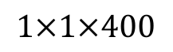
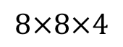
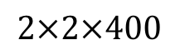
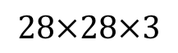
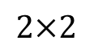
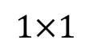
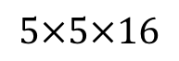
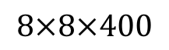
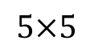
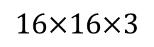
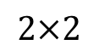
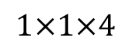
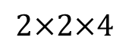
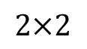
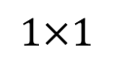
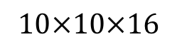
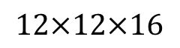
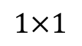
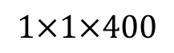
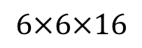
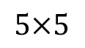
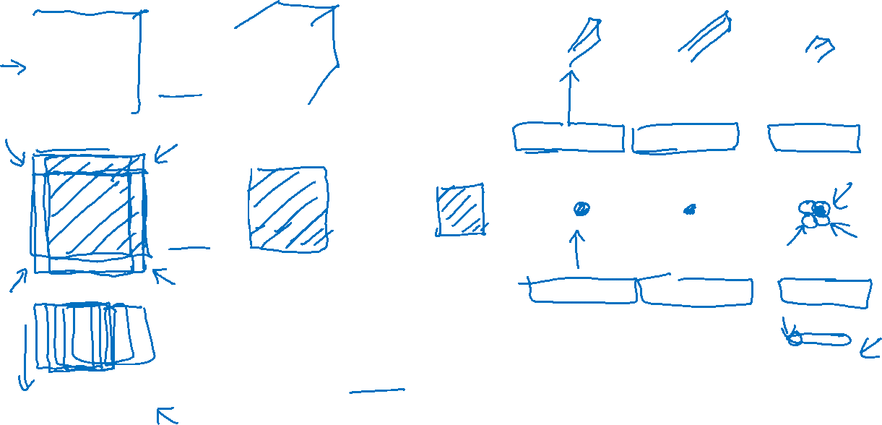
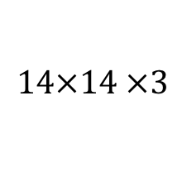
Convolution implementation of sliding windows
MAX POOL
FC
FC
FC
$$5×5$$
$$2×2$$
$$5×5$$
$$1×1$$
$$1×1$$
$$14×14 ×3$$
$$10×10×16$$
$$5×5×16$$
$$1×1×400$$
$$1×1×400$$
$$1×1×4$$
MAX POOL
FC
FC
FC
$$5×5$$
$$2×2$$
$$5×5$$
$$1×1$$
$$1×1$$
$$16×16×3$$
$$12×12×16$$
$$6×6×16$$
$$2×2×400$$
$$2×2×400$$
$$2×2×4$$
MAX POOL
$$5×5$$
$$2×2$$
$$5×5$$
$$1×1$$
$$1×1$$
$$28×28×3$$
$$24×24×16$$
$$12×12×16$$
$$8×8×400$$
$$8×8×400$$
$$8×8×4$$
[Sermanet et al., 2014, OverFeat: Integrated recognition, localization and detection using convolutional networks]

Slide 13







Convolution implementation of sliding windows
MAX POOL
$$5×5$$
$$2×2$$
$$5×5$$
$$1×1$$
$$1×1$$
$$28×28$$
$$16×16$$
$$12×12$$
$$8×8×400$$
$$8×8×400$$
$$8×8×4$$

Slide 14
Object Detection
This page is not the official page because it hasn’t provided officially. Please contact me to update if provided. ACPrime@Github
Bounding box predictions
deeplearning.ai

Slide 15

This page is not the official page because it hasn’t provided officially. Please contact me to update if provided. ACPrime@Github

Slide 16

This page is not the official page because it hasn’t provided officially. Please contact me to update if provided. ACPrime@Github

Slide 17

This page is not the official page because it hasn’t provided officially. Please contact me to update if provided. ACPrime@Github

Slide 18
Object Detection
Intersection over union
交并比
deeplearning.ai

Slide 19



Evaluating object localization
“Correct” if IoU $≥$ 0.5
More generally, IoU is a measure of the overlap between two bounding boxes.

Slide 20
Object Detection
Non-max suppression
非最大值抑制
deeplearning.ai

Slide 21
Non-max suppression example

Slide 22

Non-max suppression example
0.6
0.8
0.9
0.3
0.5

Slide 23

Non-max suppression example
0.6
0.8
0.9
0.7
0.7

Slide 24







Non-max suppression algorithm
$$\left[\begin{aligned}p_{c} \\ b_{x} \\ b_{y} \\ b_{h} \\ b_{w}\end{aligned}\right]$$
Each output prediction is:
Discard all boxes with $p_{c}≤0.6$
While there are any remaining boxes:
Pick the box with the largest $p_{c}$
Output that as a prediction.
19$×19$
Discard any remaining box with
IoU $≥0.5$with the box output
in the previous step

Slide 25
Object Detection
Anchor boxes
deeplearning.ai

Slide 26




Overlapping objects:
Anchor box 1:
Anchor box 2:
$$\left[\begin{aligned}p_{c} \\ b_{x} \\ b_{y} \\ b_{h} \\ b_{w} \\ c_{1} \\ c_{2} \\ c_{3}\end{aligned}\right]$$
y =
[Redmon et al., 2015, You Only Look Once: Unified real-time object detection]

Slide 27

Anchor box algorithm
Previously:
With two anchor boxes:
Each object in training image is assigned to grid cell that contains that object’s midpoint.
Each object in training image is assigned to grid cell that contains object’s midpoint and anchor box for the grid cell with highest IoU.

Slide 28


Anchor box example
y = $\left[\begin{aligned}p_{c} \\ b_{x} \\ b_{y} \\ b_{h} \\ b_{w} \\ c_{1} \\ c_{2} \\ c_{3} \\ p_{c} \\ b_{x} \\ b_{y} \\ b_{h} \\ b_{w} \\ c_{1} \\ c_{2} \\ c_{3}\end{aligned}\right]$
Anchor box 1:
Anchor box 2:

Slide 29
Object Detection
Putting it together:
YOLO algorithm
deeplearning.ai

Slide 30






Training
1 - pedestrian
2 - car
$\left[\begin{aligned}p_{c} \\ b_{x} \\ b_{y} \\ b_{h} \\ b_{w} \\ c_{1} \\ c_{2} \\ c_{3} \\ p_{c} \\ b_{x} \\ b_{y} \\ b_{h} \\ b_{w} \\ c_{1} \\ c_{2} \\ c_{3}\end{aligned}\right]$
$$\left[\begin{aligned}0 \\ ? \\ ? \\ ? \\ ? \\ ? \\ ? \\ ? \\ 0 \\ ? \\ ? \\ ? \\ ? \\ ? \\ ? \\ ?\end{aligned}\right]$$
$$\left[\begin{aligned}0 \\ ? \\ ? \\ ? \\ ? \\ ? \\ ? \\ ? \\ 1 \\ b_{x} \\ b_{y} \\ b_{h} \\ b_{w} \\ 0 \\ 1 \\ 0\end{aligned}\right]$$
3 - motorcycle
y
=
y is $3×3×2×8$
[Redmon et al., 2015, You Only Look Once: Unified real-time object detection]

Slide 31





Making predictions
$\left[\begin{aligned}p_{c} \\ b_{x} \\ b_{y} \\ b_{h} \\ b_{w} \\ c_{1} \\ c_{2} \\ c_{3} \\ p_{c} \\ b_{x} \\ b_{y} \\ b_{h} \\ b_{w} \\ c_{1} \\ c_{2} \\ c_{3}\end{aligned}\right]$
$$⋯$$
$y$ =
$$3×3×2×8$$

Slide 32

Outputting the non-max supressed outputs
For each grid call, get 2 predicted bounding boxes.
Get rid of low probability predictions.
For each class (pedestrian, car, motorcycle) use non-max suppression to generate final predictions.

Slide 33
Object Detection
Region proposals
(Optional)
deeplearning.ai

Slide 34


Region proposal: R-CNN
[Girshik et. al, 2013, Rich feature hierarchies for accurate object detection and semantic segmentation]

Slide 35

Faster algorithms
R-CNN:
Propose regions. Classify proposed regions one at a time. Output label + bounding box.
Fast R-CNN:
Propose regions. Use convolution implementation of sliding windows to classify all the proposed regions.
Faster R-CNN:
Use convolutional network to propose regions.
[Girshik et. al, 2013. Rich feature hierarchies for accurate object detection and semantic segmentation]
[Girshik, 2015. Fast R-CNN]
[Ren et. al, 2016. Faster R-CNN: Towards real-time object detection with region proposal networks]

